Slide 1
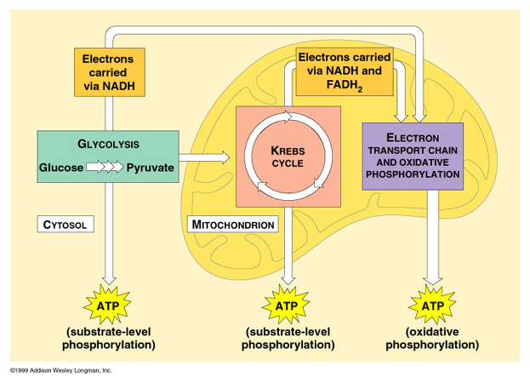
Chapter 9-2
Cellular Respiration
The Kreb’s Cycle & Electron Transport Chain

Slide 2
Kreb’s Cycle
What is it?
  With oxygen, the Kreb’s cycle is the 2nd stage of cellular respiration.
What Happens?
  Pyruvic acid (from glycolysis) is broken down into Carbon Dioxide in a series of energy-releasing reactions

Slide 3
Kreb’s Cycle Continued…
CFU: Explain your answers!
Is Oxygen required for Glycolysis?
No – it can supply energy when O2 is not available.
Is oxygen required for the Kreb’s Cycle?
  Yes – if it did not have oxygen, fermentation would take place

Slide 4
Electron Transport Chain
What comes after the Kreb’s Cycle?
  The Electron Transport Chain
What is the Electron Transport Chain?
  Uses high-energy electrons (NADH) from the Kreb’s cycle to convert ADP into ATP.

Slide 5
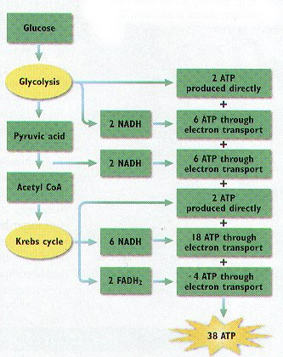
The Energy Totals
Glycolysis Total:
  2 ATP
Kreb’s Cycle &
Electron Transport
Total:
  34 ATP
TOTAL:
  36 ATP
Investment
36 ATP

Slide 6
Energy & Exercise
Quick Energy
  Such as: Running from danger!
  Comes from:
    Glycolysis
    Lactic Acid
      Fermentation

Slide 7

Energy & Exercise
Long-Term Energy
  Such as: Marathon
  Comes from:
    Cellular Respiration
      Glycolysis
      Kreb’s Cycle
      Electron Transport Chain

Slide 8
Photosynthesis VS Cell Respiration
Opposite Processes!
Equations are reversed!
Photosynthesis
6CO₂ + 6H₂O C₆H₁₂O₆ + 6O₂
Carbon Dioxide + Water Sugar + Oxygen
Cellular Respiration
C₆H₁₂O₆ + 6O₂ 6CO₂ + 6H₂O
Sugar + Oxygen Carbon Dioxide + Water

Slide 9
Photosynthesis VS Cell Respiration
Photosynthesis Cellular Respiration
Function
Energy Storage Energy Release
Location
Chloroplasts Mitochondria
Reactants
Carbon Dioxide and Water Sugar and Oxygen
Products
Sugar and Oxygen Carbon Dioxide and Water

